Slide 1
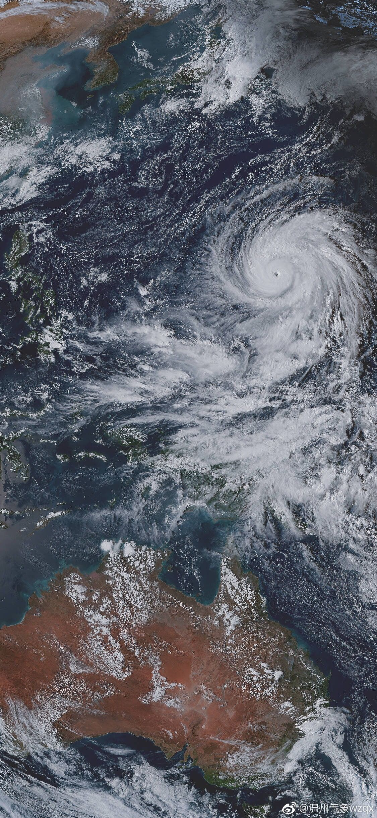
EDA to Typhoon Mitigation and Response Framework (TMRF)
Integration of Global Plans for a Better Typhoon Disaster Response
Presented by:
TEAM TYPHOON ANALYST
Alvaro, Gabriel Edrian
Palis, John Arthur
Alangilan, Christine Joy
Guerra, Marian

Slide 2
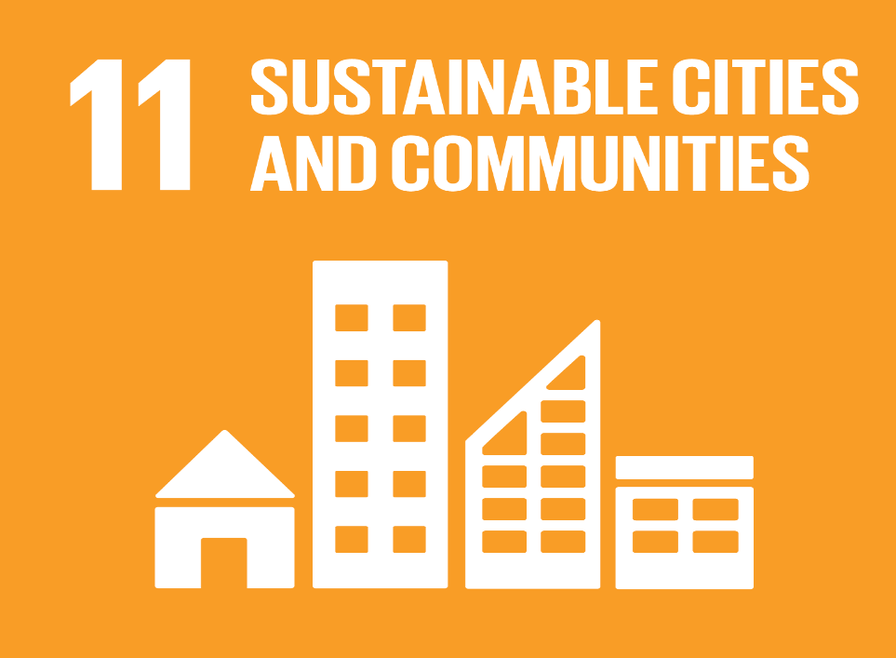
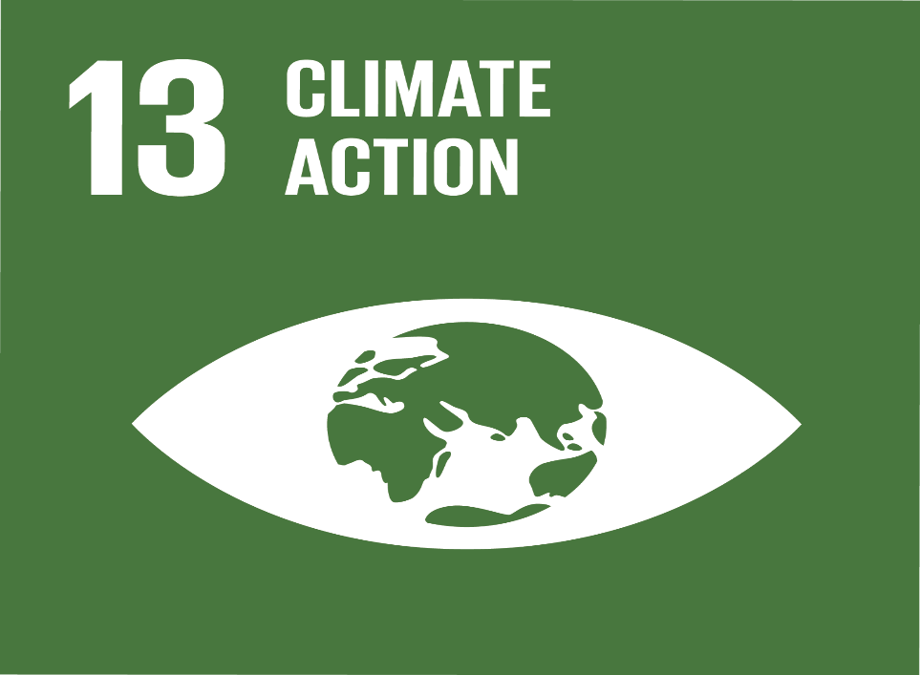
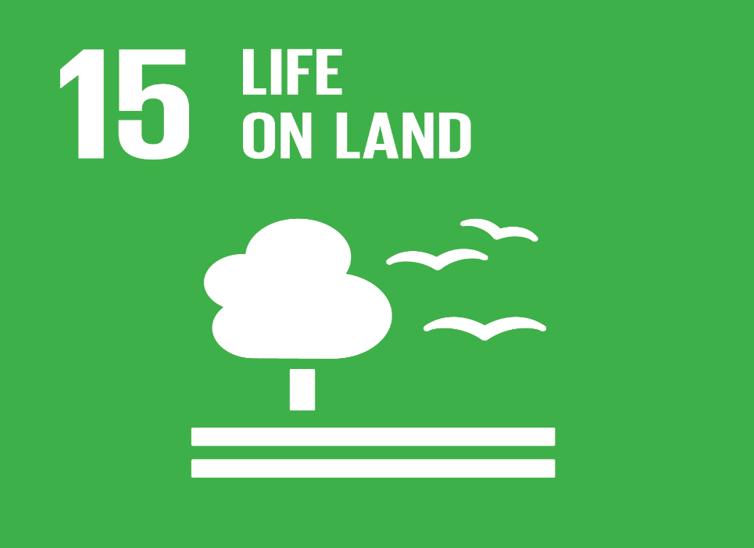
Goal 11: Sustainable Cities and Communities
Sustainable Development Goals
It stives to mitigate the negative consequences of natural catastrophes like typhoons.
Goal 13: Climate Action
It stives to take immediate action to address climate change and its consequences.
Goal 15: Life on Land
It seeks to manage forest sustainability, prevent desertification, halt and reverse land degradation, and halt biodiversity loss.

Slide 3
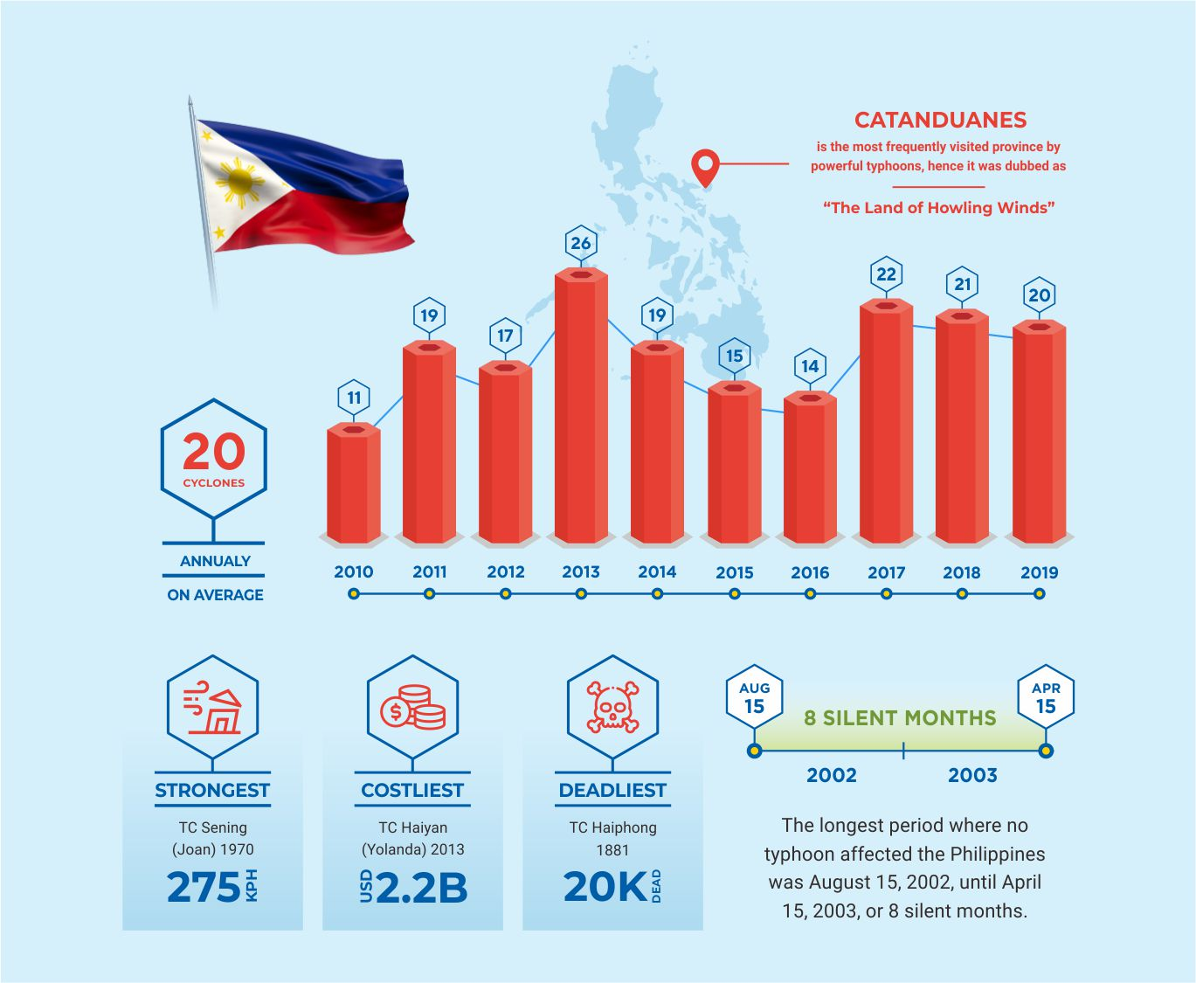
DID YOU KNOW?
- Approximately, Twenty tropical cyclones pass through the Philippine Area of Responsibility per year (Brown, 2013).
- Insufficient public awareness of storm surges caused higher casualties Tacloban city. (Commision on Audit, n.d.).
“Experience is a master teacher, even when it’s not our own.” ― Gina Greenlee

Slide 4

PROBLEM STATEMENT
The primary issue addressed by this project is the lack of a mitigation and response framework among the cities and municipalities located throughout the Philippine archipelago.

Slide 5
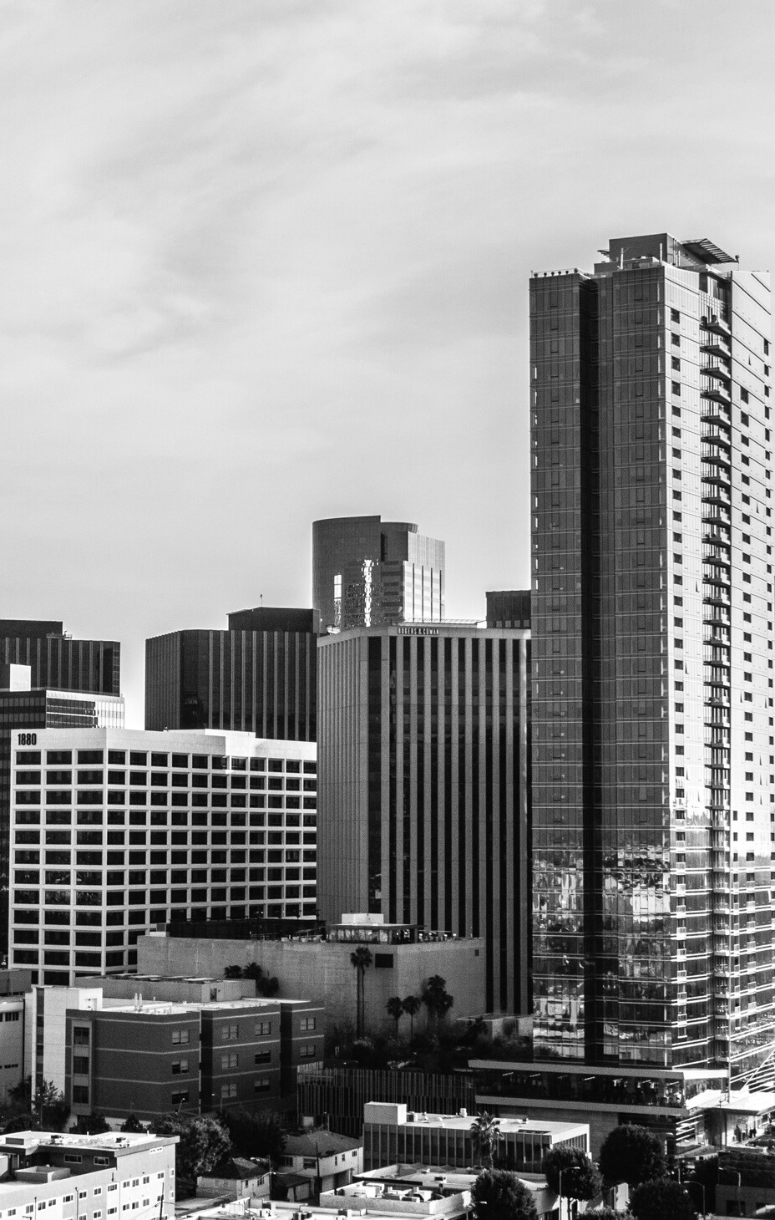


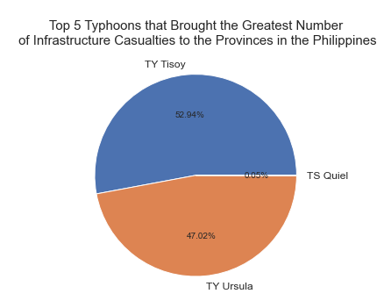
TYPHOON TISOY
Typhoon Tisoy has the most destructive impact on the houses in every region in the Philippines from 2019 with a 68,104 in number. While TY Ursula has the second highest number with 60,483 housing damaged. Why did this happened?
68,104
TYPHOON TISOY TYPHOON URSULA
TYPHOON QUIEL
Totally Damaged Houses
Notes:
A recent Harvard research found that despite the fact that the Philippines is one of the most disaster-prone nations in the world, the majority of Filipino households feel unprepared for catastrophes and natural hazards due to a lack of financial resources. In 2017, Harvard Humanitarian Initiative (HHI) DisasterNet Philippines conducted the first survey of its type to gauge household preparation for disasters, reaching 4,368 families around the country (Enano, 2019). According to the survey report, just 36% of respondents felt completely prepared for disasters, while 33% reported being moderately prepared. The other third of respondents reported to be just minimally or not at all prepared for natural disasters such as typhoons, earthquakes, floods, and landslides. Over nine million Filipinos have been impacted by a natural catastrophe in the previous five years, according to the HHI. However, over 47 percent of respondents indicated they had made no preparations for these disasters. Despite the fact that the majority of respondents claimed to have discussed emergency preparations with family members, the majority do not have "go bags" or emergency bags or even first aid kits, according to the survey.

Slide 6
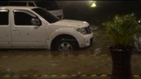

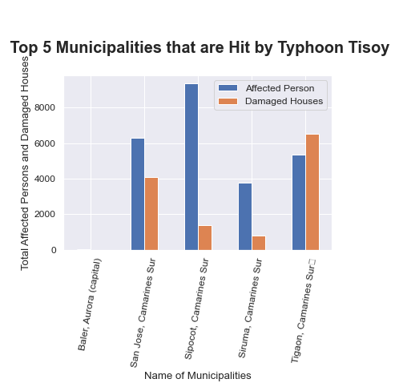
SIPOCOT, CAMARINES SUR
TYPHOON TISOY TYPHOON URSULA
TYPHOON QUIEL
136.0
Totally Damaged Houses
Source: Earth Uncut TV (2019)
Notes:
From the graph above, it can be concluded that most of the municipalities who were greatly affected by Typhoon Tisoy is from Camarines Sur, Bicol Region. These municipalities includes San Jose, Sipocol, Sinuma, and Tigaon.
In the aftermath of Typhoon Tisoy, the Bicol area (Region 5) was hit particularly severely, with over 1,200,000 people impacted and over 256,000 homes damaged or destroyed. According to 2018 data, 27 percent of Bicol's population lives below the poverty line, and its primary economic activities include fishing and farming. Prior to Typhoon Tisoy, there were significant risks among the affected population, notably among low-income households dwelling in high-risk regions and in buildings built of lightweight materials (Humanitarian Country Team, 2019). The region's geographic location renders it susceptible to natural disasters, and several regions of the region were affected by Typhoon Nina in 2017 and Typhoon Usman in 2018, prompting the communities to create emergency planning and response plans that rely largely on their own resources.

Slide 7
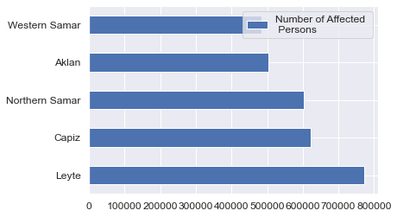


LEYTE
WESTERN SAMAR
772162.0
483308.0
AFFECTED INDIVIDUALS
AFFECTED INDIVIDUALS
Notes:
What do these provinces lack in terms of disaster preparedness, particularly for Typhoons?
According to the Policy Brief - Senate Economic Planning Office (2017), a large proportion of individuals impacted by typhoons are due to the inability of line agencies and LGUs to conduct DRRM responsibilities . The inability of line agencies and LGUs to adopt DRRM responsibilities is an often stated problem in Philippine disaster management. Insufficient personnel, lack of technical expertise and comprehension, limited financial resources, and lack of technology, such as a multi-hazard early warning system, are among the causes. The LGUs lack the technical expertise and resources necessary to fulfill their statutory responsibilities. The DILG-Bureau of Local Government Supervision's 2013 national table assessment on LGU compliance with RA No. 10121 revealed that just 23 percent of LGUs in flood-prone regions are prepared for catastrophes in terms of knowledge, institutional capacity, and coordination.

Slide 8
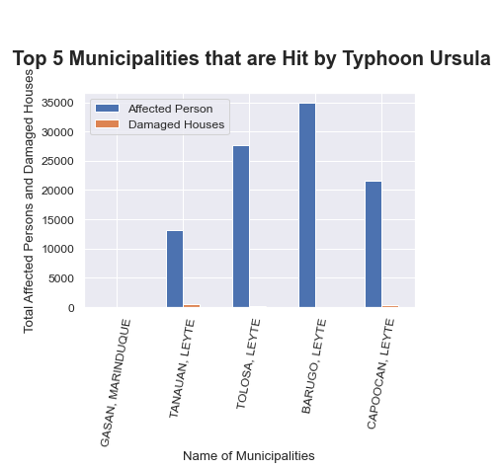


Barugo, Leyte
34932.0
TYPHOON URSULA
Barugo, Leyte
Total Affected Persons
Most affected Municipality

Slide 9
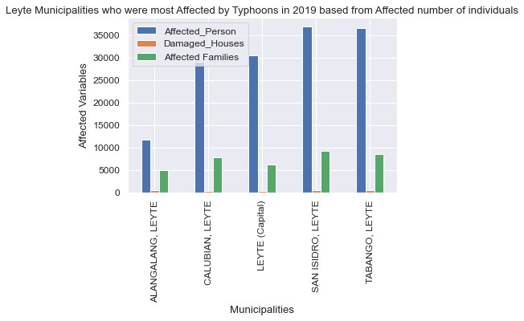
SAN, ISIDRO, LEYTE
ALANGALANG, LEYTE
36980.0
11680.0
AFFECTED INDIVIDUALS
AFFECTED INDIVIDUALS
Notes:
Leyte is weak in data banking and community preparation, which caused the massive number of affected individuals to their province.
According to Therese Mae Auman, as reported by the Asian Institute of Management (n.d.), Western Visayas, including Leyte, were severely weak in two important areas: data banking and community preparation. She saw that local administrations struggled to retain systematic data and records on prior disasters. Local Government Units in her area of responsibility do not have a database with information about prior catastrophes from which they may quickly acquire and use the material when drafting local plans. There is no progress in limiting property loss or potential deaths as a result of a community's experience with damaging storms due to the absence of data storage, which increases the likelihood that history will repeat again. The lack of community preparedness was mostly a communication issue. While populations were educated and supplied with information about evacuating as crises unfolded, execution remained a constant obstacle. There were no planned evacuation plans in place to rapidly and efficiently mobilize neighborhood people. Communities are informed of the dangers in their region, and several drills have already been done. However, according to Auman, once a calamity hits, everyone scrambles.

Slide 10
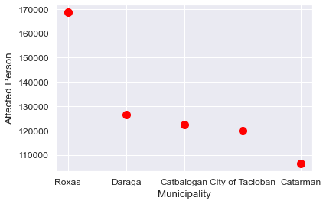
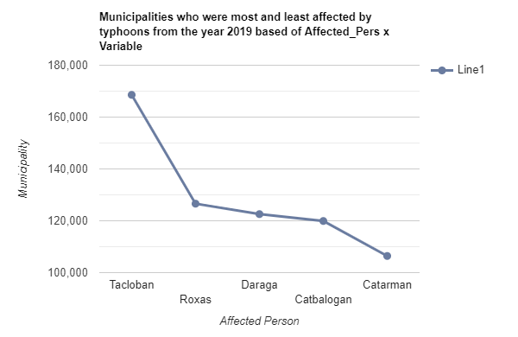
OBJECTIVES
Humanitarian Data Exchange Data set about Philippines (2019)
Objective 1
Objective 2
Objective 3
The Centre for Research on the Epidemiology of Disasters' Data set about the American Typhoons (2000-2022)
TOP 5
MUNICIPALITIES
Who had the most affected individuals in the year 2019
Notes:
CITY OF ROXAS (CAPITAL) 168580.0
Daraga (Locsin) 126595.0
CITY OF CATBALOGAN (CAPITAL) 122572.0
CITY OF TACLOBAN (CAPITAL) 119918.0
Catarman (capital) 106424.0
The ineffective execution of rules and regulations in these municipalities contributed to their severe typhoon damage. In low-lying and high-risk regions, a proliferation of establishments and informal settlers has resulted from a lack of administration and lax implementation of disaster-related rules (no building zones). According to the 2009 Annual Report of the Global Facility for Disaster Reduction and Recovery (GFDRR), as stated by Policy Brief - Senate Economic Planning Office (2017), several constructions do not comply with the Building Code and Environmental Compliance Certificates (ECCs). In certain local government units, building regulations and standards are weakened to minimize construction costs. In disaster-prone locations, a lack of control in the construction of buildings and other physical structures contributes to an increase in community risk.

Slide 11
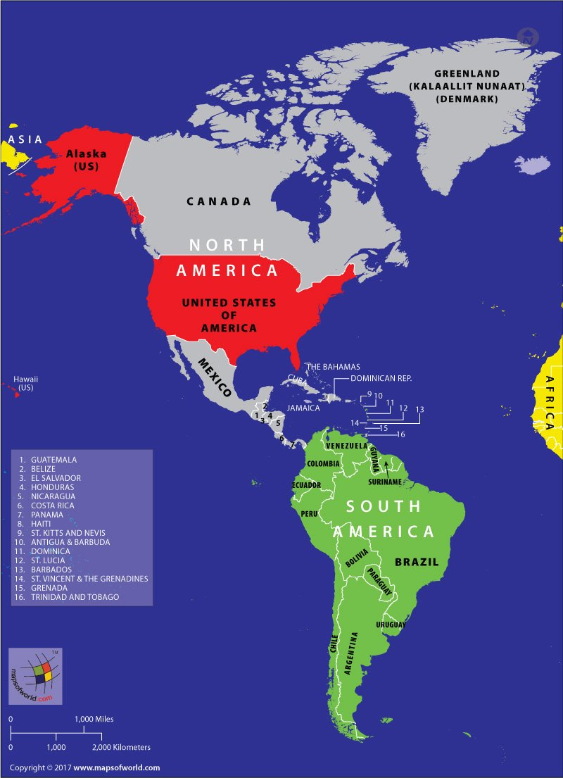
The American Continent
Source: Maps of World (2021)
Notes:
For the year 2000-2021, a total of 146 hurricanes were being recorded that hit the whole American continents, having Hurricane Katrina, Harvey, Maria, Irma, and Ida as top 5 strongest hurricanes in that timeline in terms of the total damage.
To determine the mitigation plans of affected countries that may help in formulating new mitigation plan for the Philippines, our group decided to look at the countries ranking with the :
-highest number of total affected individuals
-lowest total deaths
-and lowest total cost of damage.
The United States is adept at coping with storms on the continent after they have struck. America is significantly more prepared for storms now than it was in 2005, when Hurricane Katrina struck (The Economists, 2018). Thus, the Philippine government should examine the methods and structures it employs to further enhance our response to and mitigation of typhoons.

Slide 12
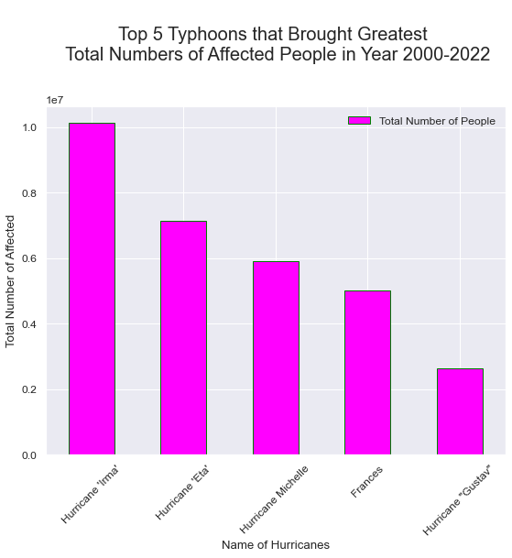
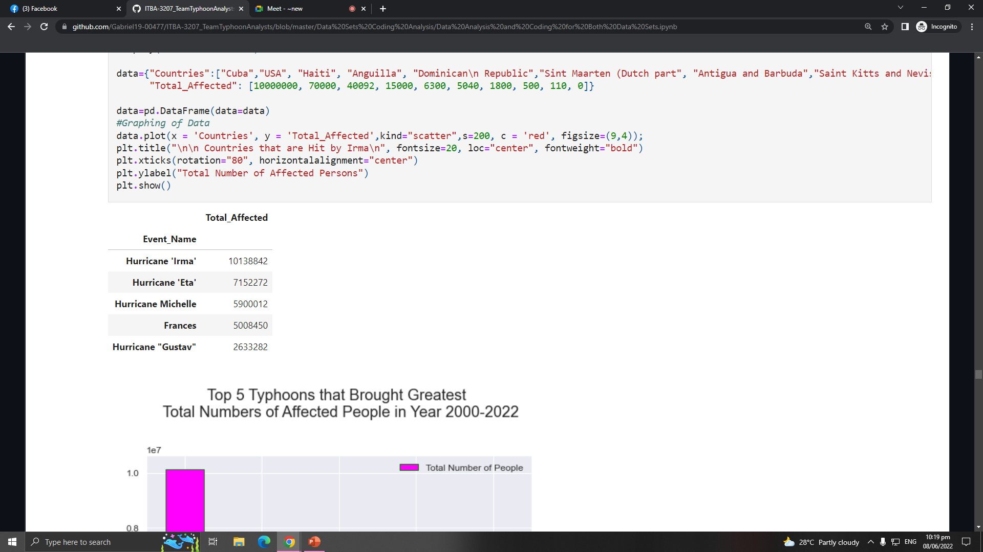

OBJECTIVES
Humanitarian Data Exchange Data set about Philippines (2019)
The Centre for Research on the Epidemiology of Disasters' Data set about the American Typhoons (2000-2022)
Objective 1
Objective 2
Objective 3
Objective 4
Objective 5
HURRICANE
IRMA

Slide 13
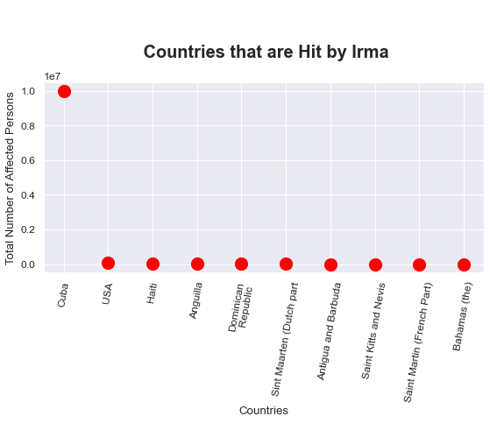
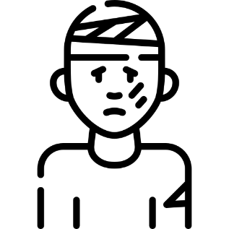
OBJECTIVES
Humanitarian Data Exchange Data set about Philippines (2019)
The Centre for Research on the Epidemiology of Disasters' Data set about the American Typhoons (2000-2022)
Objective 1
Objective 2
Objective 3
Objective 4
Objective 5
10M
HURRICANE IRMA
TOTAL AFFECTED PERSON IN CUBA BY THE HURRICANE IRMA

Slide 14
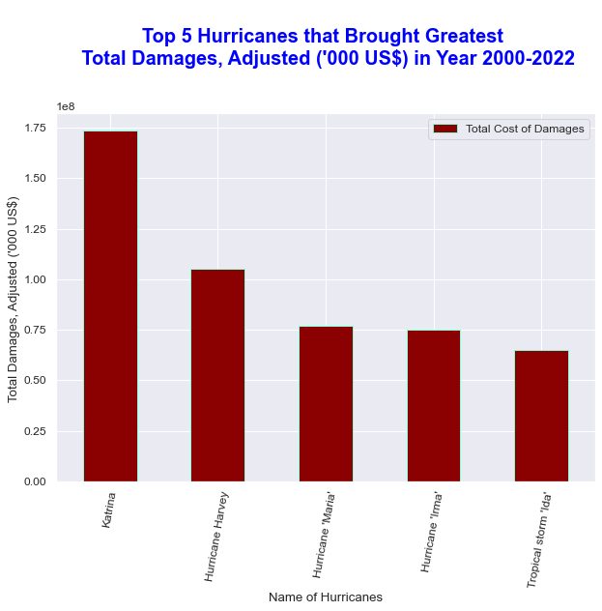
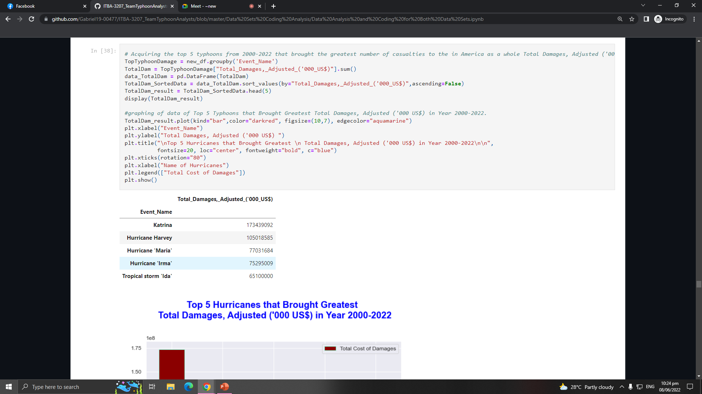
OBJECTIVES
Humanitarian Data Exchange Data set about Philippines (2019)
The Centre for Research on the Epidemiology of Disasters' Data set about the American Typhoons (2000-2022)
Objective 1
Objective 2
Objective 3
Objective 4
Objective 5
HURRICANE
KATRINA

Slide 15
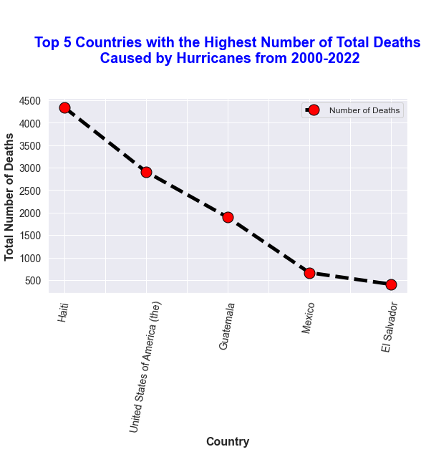
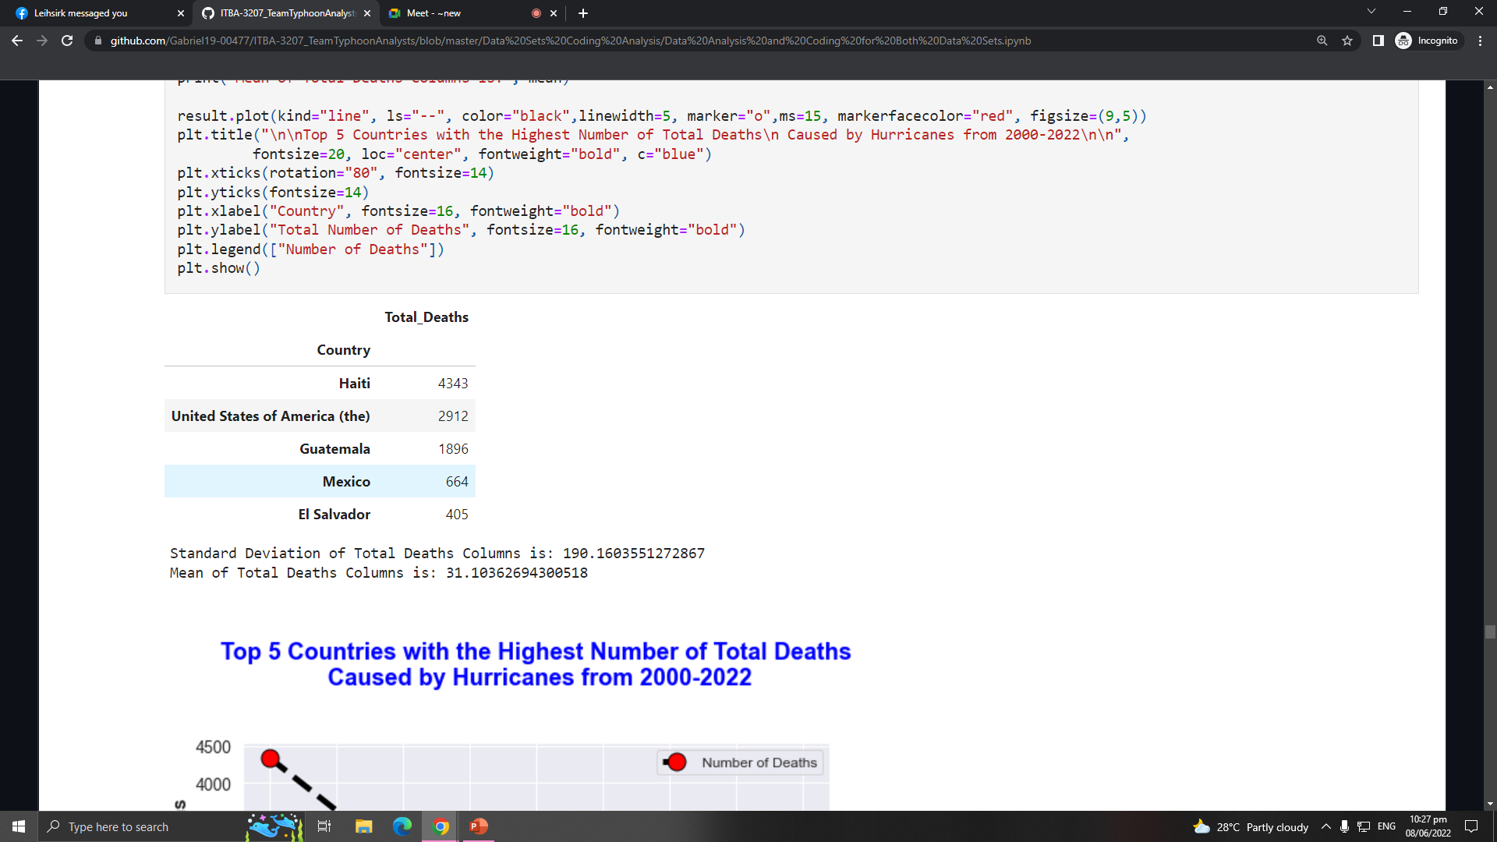
OBJECTIVES
Humanitarian Data Exchange Data set about Philippines (2019)
The Centre for Research on the Epidemiology of Disasters' Data set about the American Typhoons (2000-2022)
Objective 1
Objective 2
Objective 3
Objective 4
Objective 5
HAITI
4343
TOTAL DEATHS

Slide 16
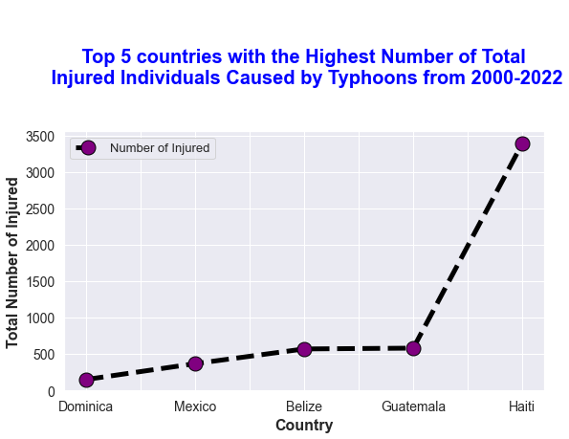
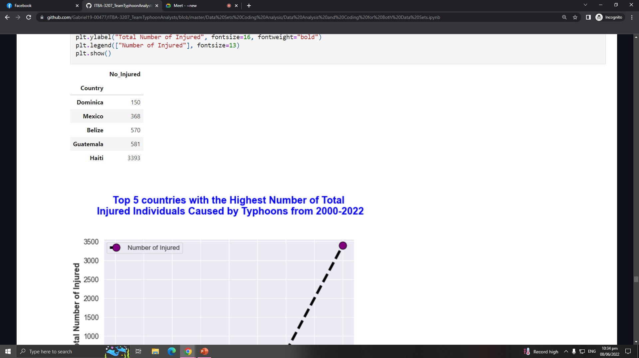

OBJECTIVES
Humanitarian Data Exchange Data set about Philippines (2019)
The Centre for Research on the Epidemiology of Disasters' Data set about the American Typhoons (2000-2022)
Objective 1
Objective 2
Objective 3
Objective 4
Objective 5
3393
150
NUMBER OF INJURED IN HAITI
NUMBER OF INJURED IN DOMINICA

Slide 17
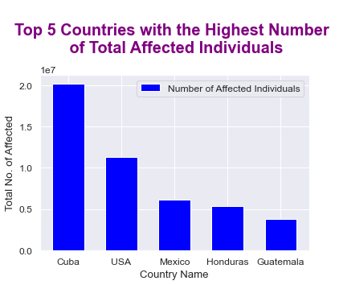
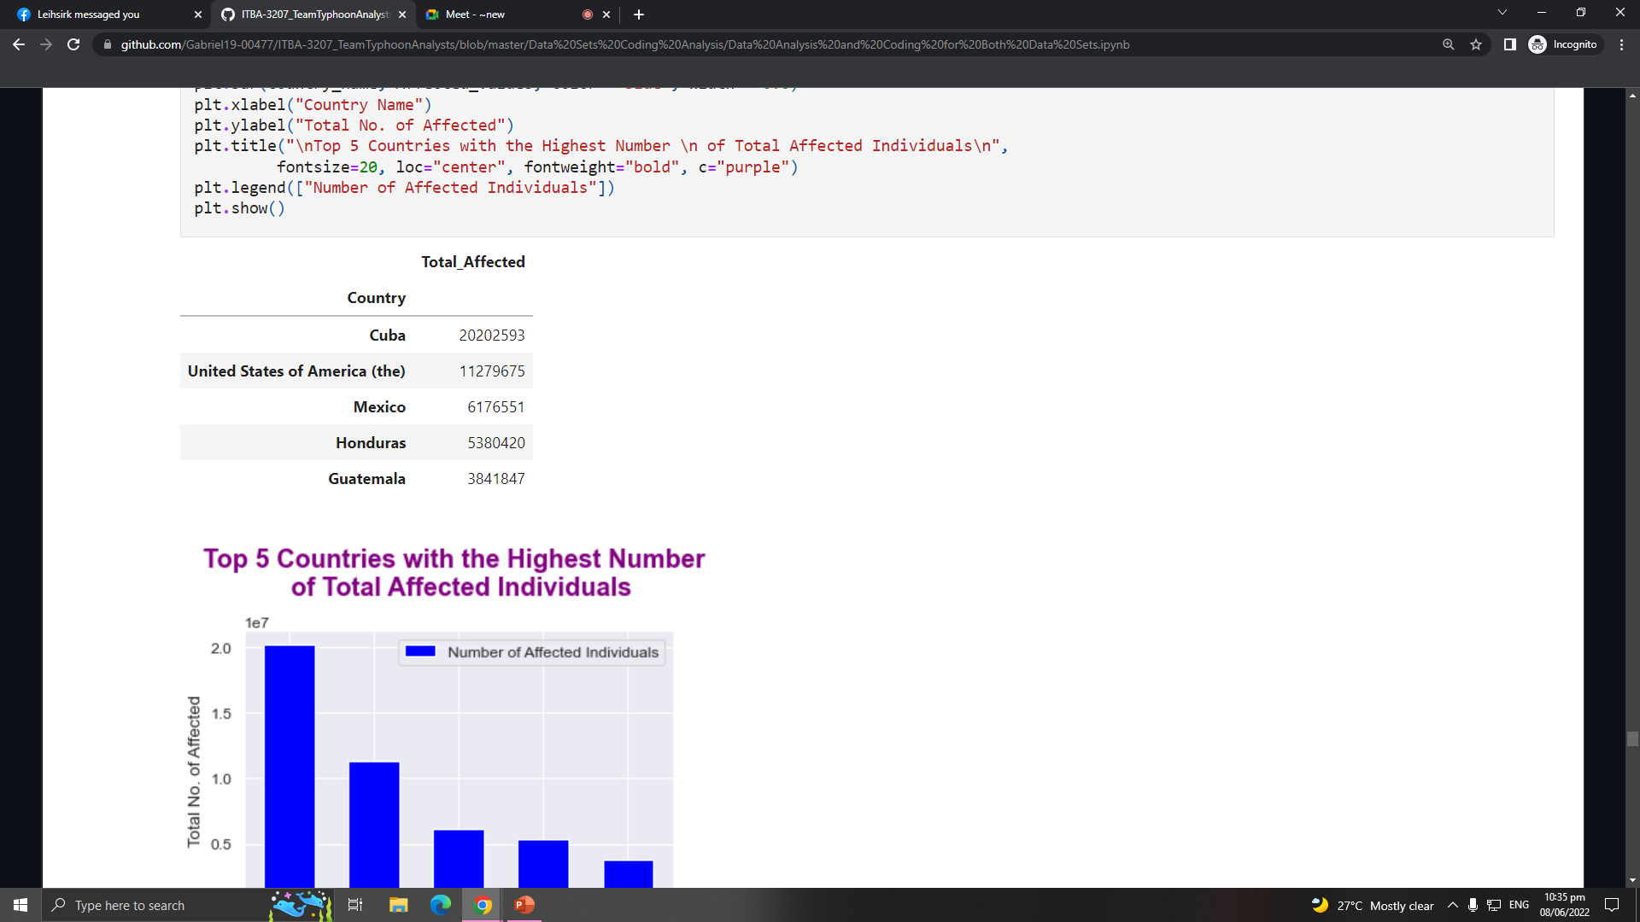
OBJECTIVES
Humanitarian Data Exchange Data set about Philippines (2019)
The Centre for Research on the Epidemiology of Disasters' Data set about the American Typhoons (2000-2022)
Objective 1
Objective 2
Objective 3
Objective 4
Objective 5
20202593.0
TOTAL AFFECTED INDIVIDUALS IN CUBA

Slide 18
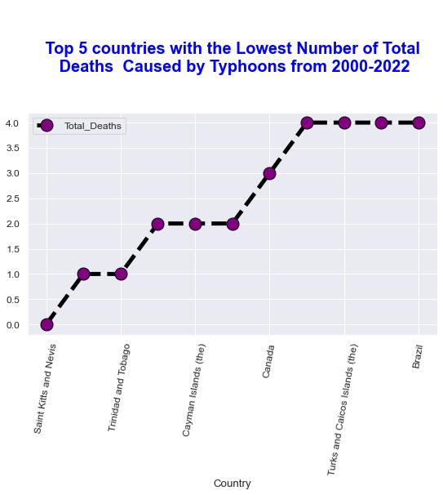
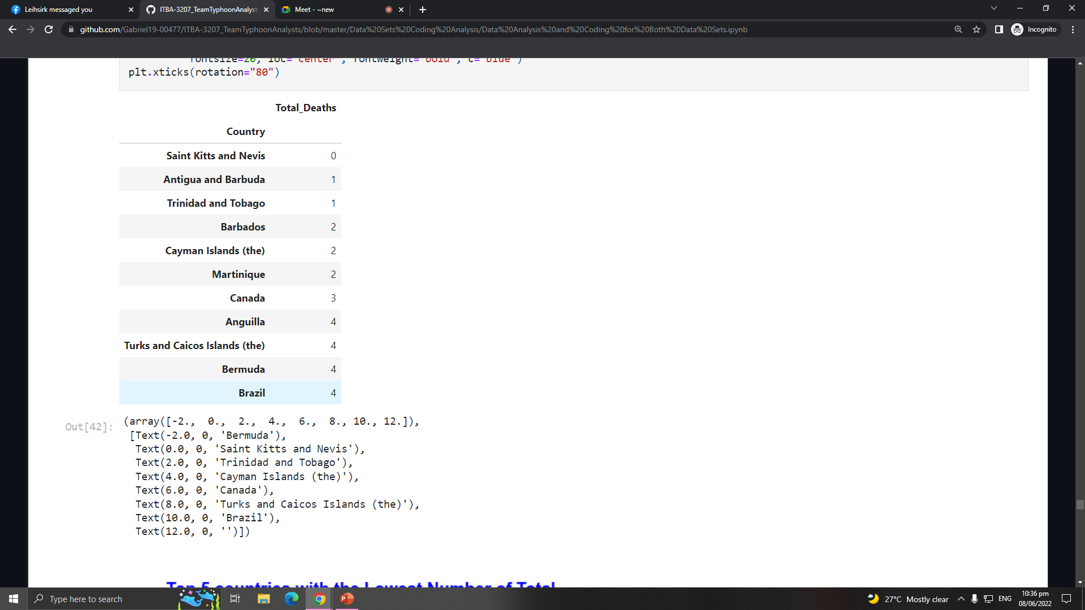
OBJECTIVES
Humanitarian Data Exchange Data set about Philippines (2019)
The Centre for Research on the Epidemiology of Disasters' Data set about the American Typhoons (2000-2022)
Objective 1
Objective 2
Objective 3
Objective 4
Objective 5
Saint Kitts and Nevis
Lowest Number of Total Deaths

Slide 19
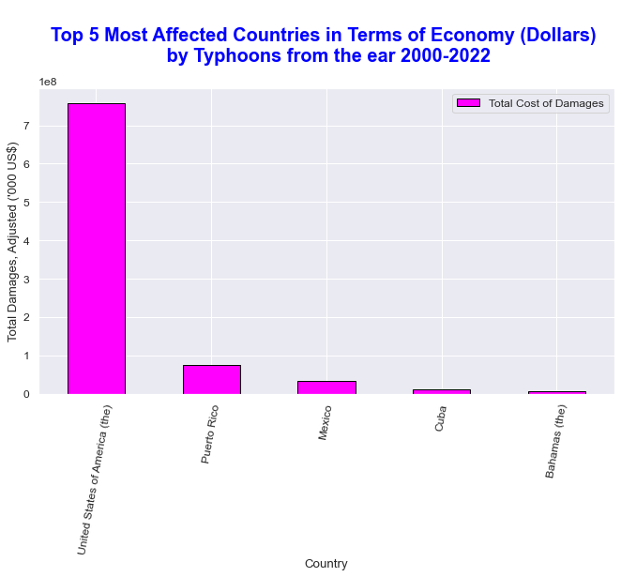
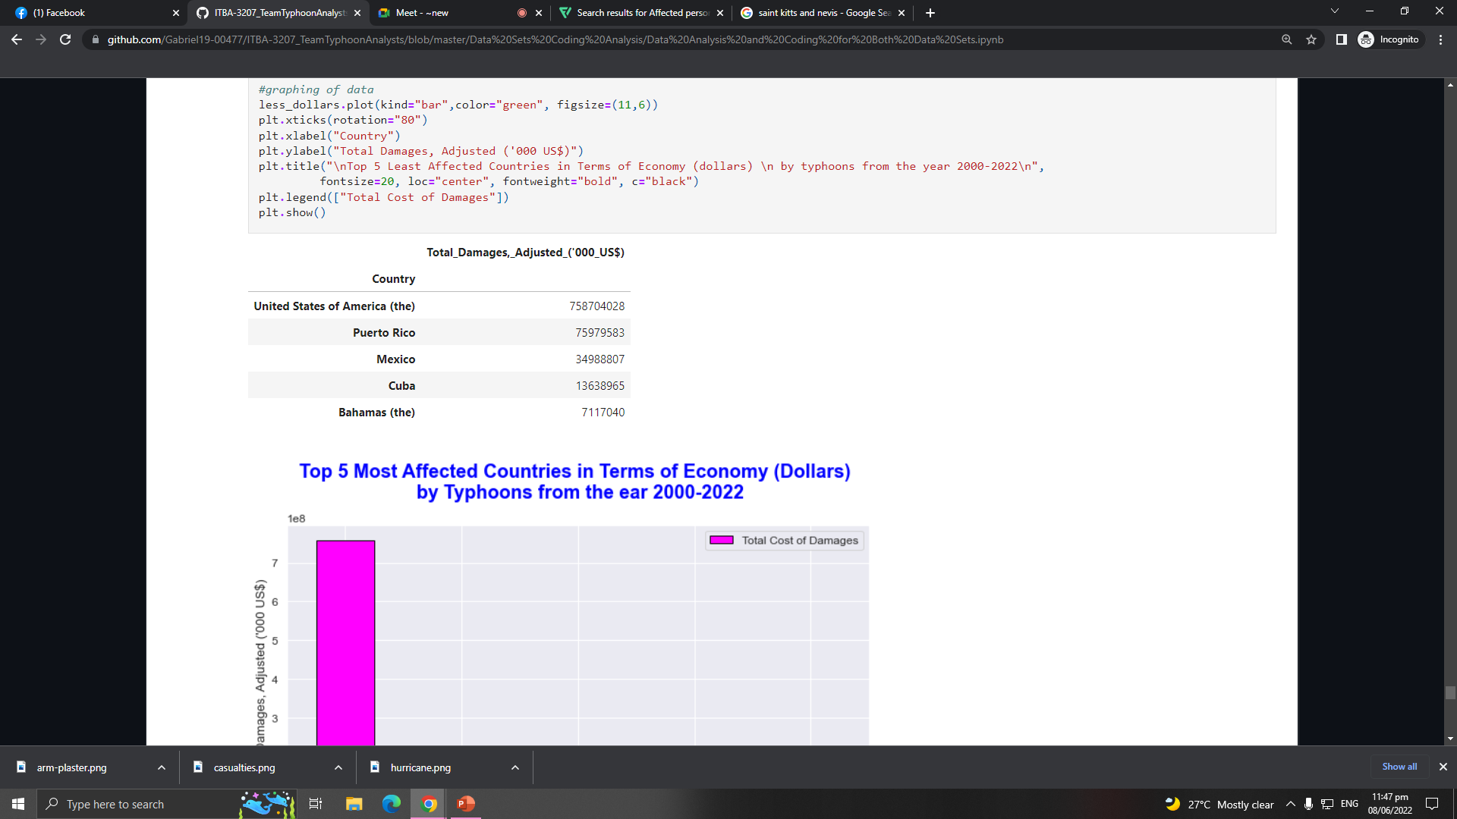
OBJECTIVES
Humanitarian Data Exchange Data set about Philippines (2019)
The Centre for Research on the Epidemiology of Disasters' Data set about the American Typhoons (2000-2022)
Objective 1
Objective 2
Objective 3
Objective 4
Objective 5
USA
MOST AFFECTED COUNTRY HAVING MORE THAN 700 BILLION TOTAL COST OF DAMAGES

Slide 20
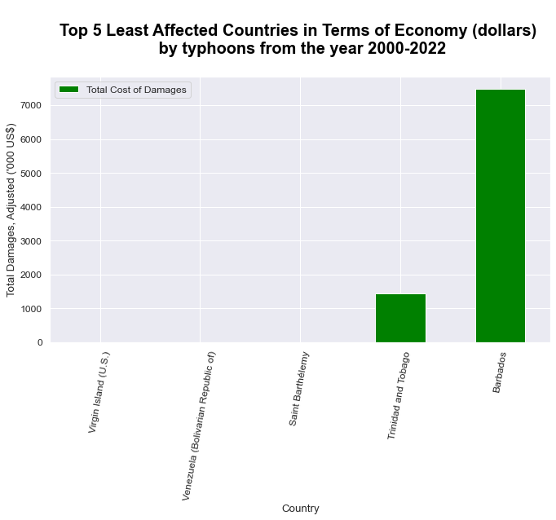
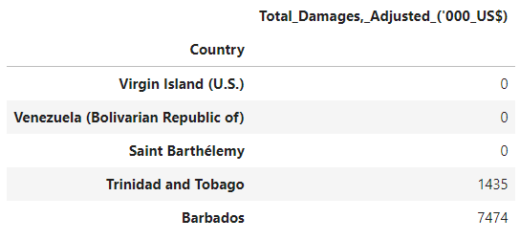
OBJECTIVES
Humanitarian Data Exchange Data set about Philippines (2019)
The Centre for Research on the Epidemiology of Disasters' Data set about the American Typhoons (2000-2022)
Objective 1
Objective 2
Objective 3
Objective 4
Objective 5
Virgin Islands, Venezuela, and Saint Barthelemy
No Record of Total Cost of Damages

Slide 21
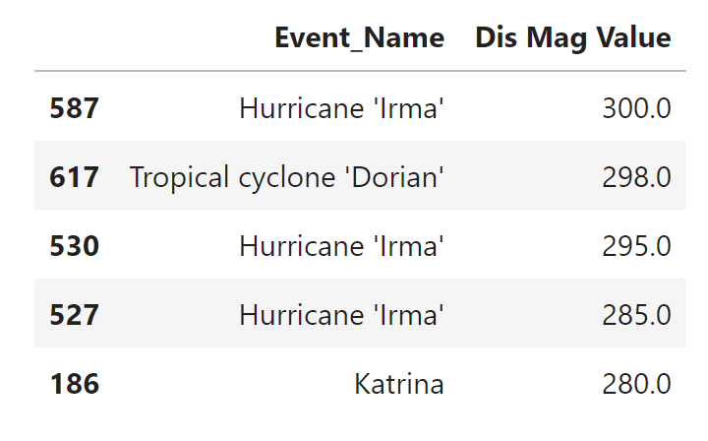
OBJECTIVES
Humanitarian Data Exchange Data set about Philippines (2019)
The Centre for Research on the Epidemiology of Disasters' Data set about the American Typhoons (2000-2022)
Objective 1
Objective 2
Objective 3
Objective 4
Objective 5

Slide 22


Source of Datasets
HDX
An open platform for sharing data across crises and organizations and goal of it to make humanitarian data easy to find and use for analysis.
CRED
The Centre promotes research, training and technical expertise on humanitarian emergencies, particularly in public health and epidemiology.

Slide 24




MEET THE TEAM
TEAM TYPHOON ANALYST
Gabriel Alvaro
Project Manager
John Palis
Presentation Manager
Christine Alangilan
Documentation Director
Marian Guerra
Quality Assurance Analyst

